Slide 1
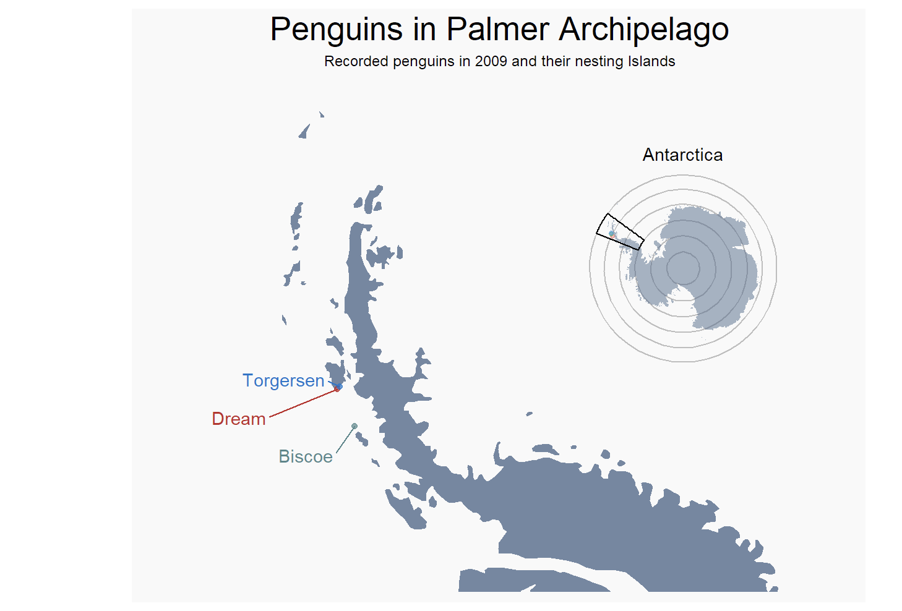
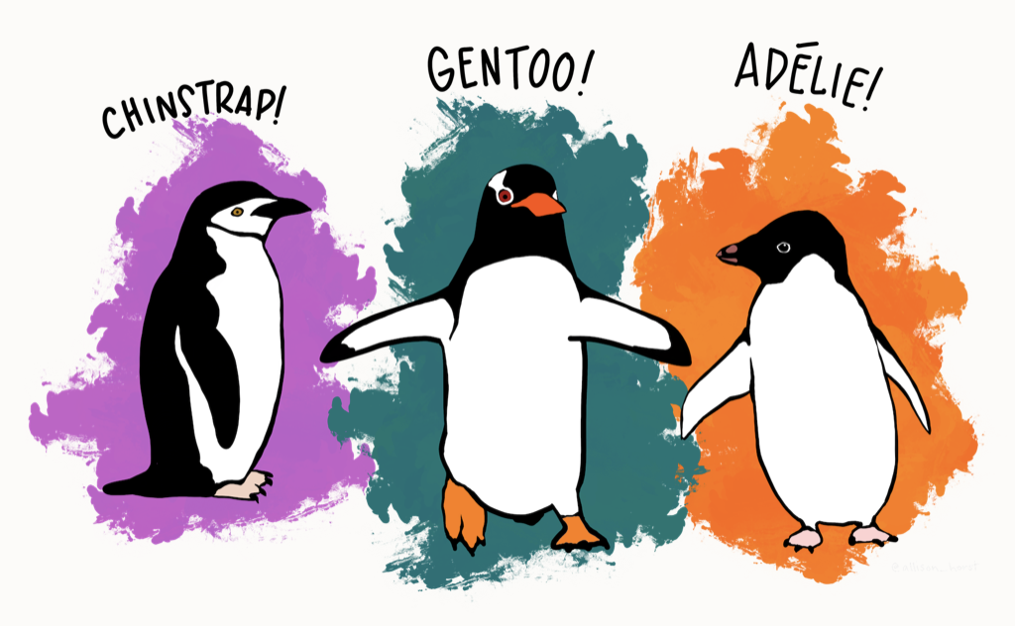
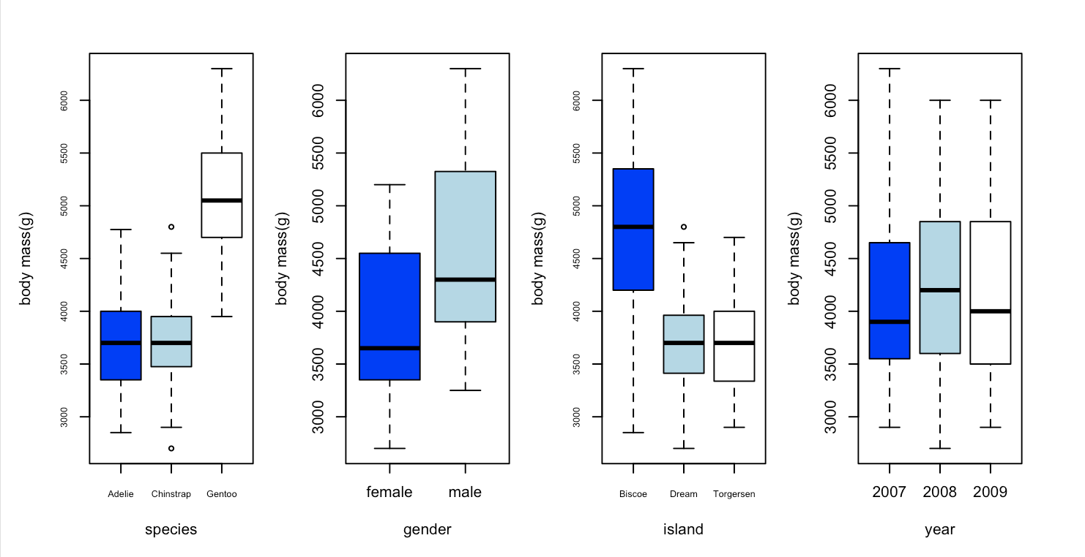
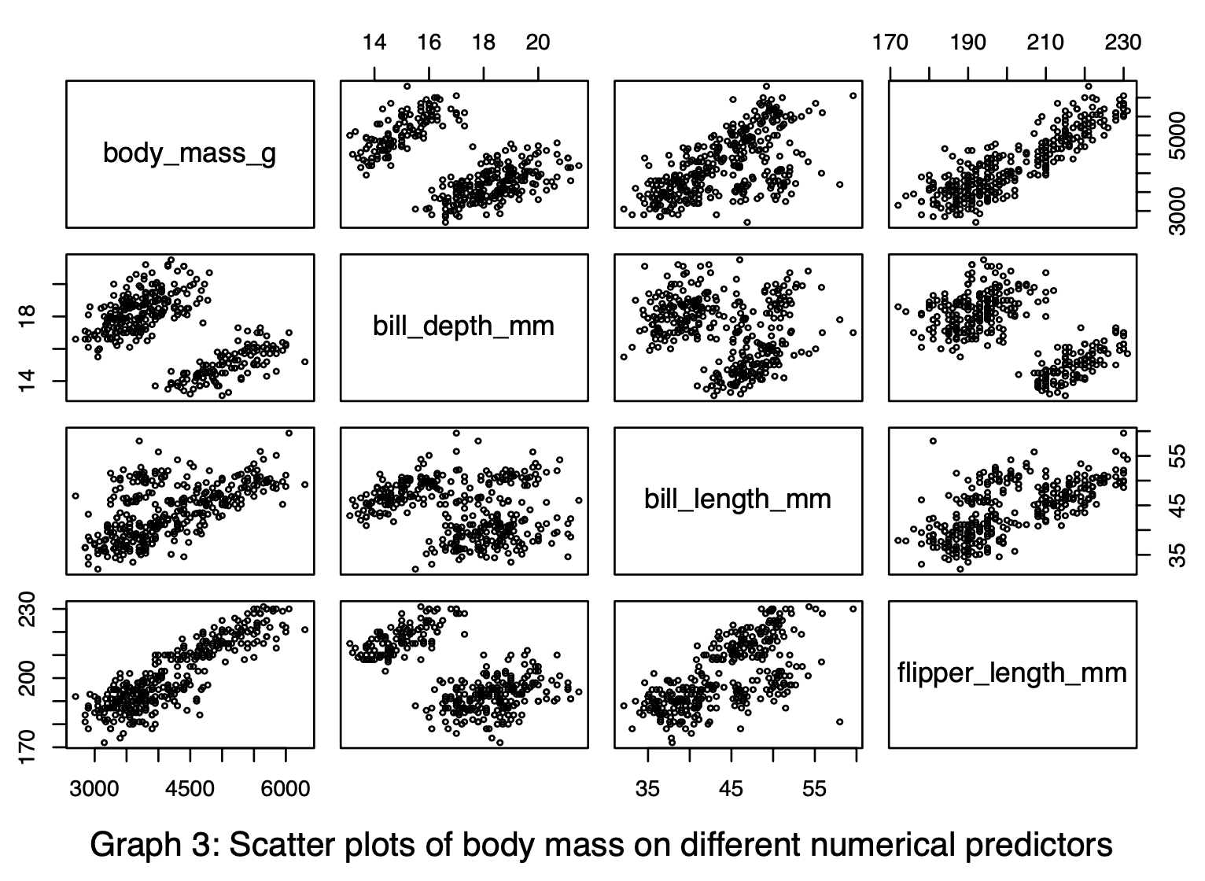
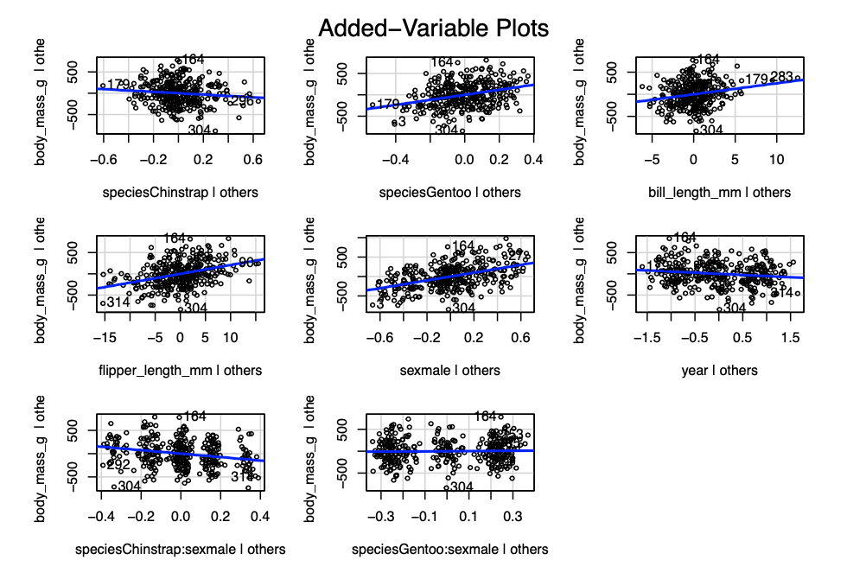
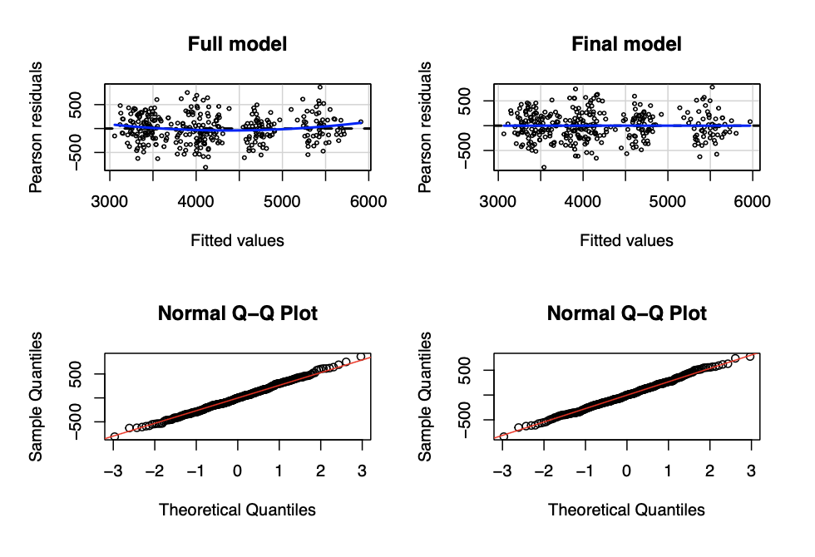

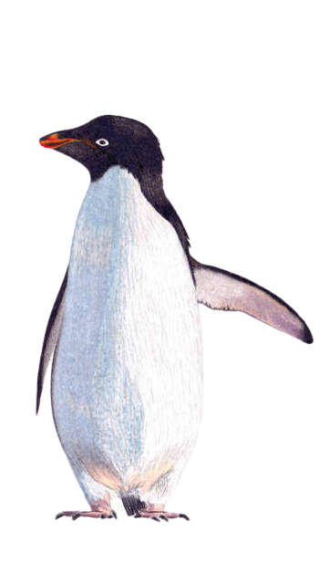
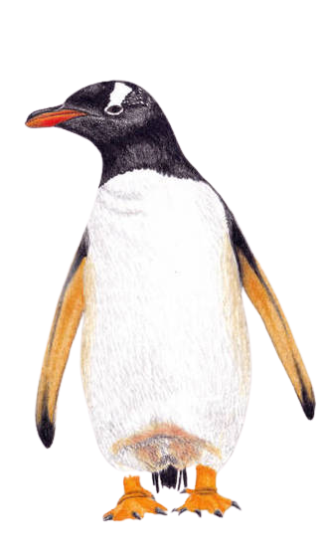
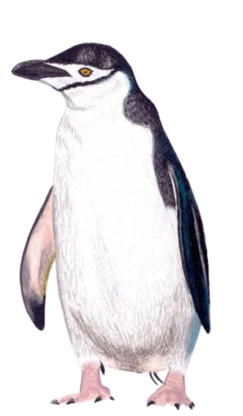
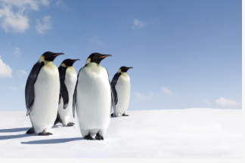
REFERENCES
CONCLUSION
Here is the abstract
INTERPRETATION / PREDICTION
DIANOSTIC CHECK
EXPLORATORY ANALYSIS
Here is the problems
DETAIL ANALYSIS
Here is the Questions
Here is Detail anaysis
QUESTION OF INTEREST
Here is the Exploration
DATA DESCRIPSTION
Here is the Interpret/Prediction
PALMER PENGUINS
Final model uses Species, Bill Length, Flipper Length, Sex, Year, and interaction of Species and Sex .
Model can be useful in conservation biology
Decline in body mass observed over study years could indicate potential threats to penguin populations.
Help identify and mitigate threats to protect the penguin population
Need for further research in conservation biology.
PROBLEMS & MOTIVATION
Here is the References
ABSTRACT
GROUP 1:
HUITING WU
CLAUDIO HERNANDEZ GARCIA
MICHELLE JOYCE PIRA
THU TRAN

Slide 2
REFERENCES
CONCLUSION
In this analysis, we use “Palmer penguins" dataset created by Dr. Kristen Gorman’s dataset who is a Marine Biology’s professor
We use different statistic method to build a multiple linear model that help us to estimate the body mass of penguins living in Antarctica by using species, island, sex, and other measurements of penguins’ bill and flipper.
INTERPRETATION / PREDICTION
DIANOSTIC CHECK
EXPLORATORY ANALYSIS
Here is the problems
DETAIL ANALYSIS
Here is the Questions
Here is Detail anaysis
QUESTION OF INTEREST
Here is the Exploration
DATA DESCRIPSTION
Here is the Interpret/Prediction
Final model uses Species, Bill Length, Flipper Length, Sex, Year, and interaction of Species and Sex .
Model can be useful in conservation biology
Decline in body mass observed over study years could indicate potential threats to penguin populations.
Help identify and mitigate threats to protect the penguin population
Need for further research in conservation biology.
PROBLEMS & MOTIVATION
Here is the References
ABSTRACT
PALMER PENGUINS
GROUP :
HUITING WU
CLAUDIO HERNANDEZ GARCIA
MICHELLE JOYCE PIRA
THU TRAN

Slide 3
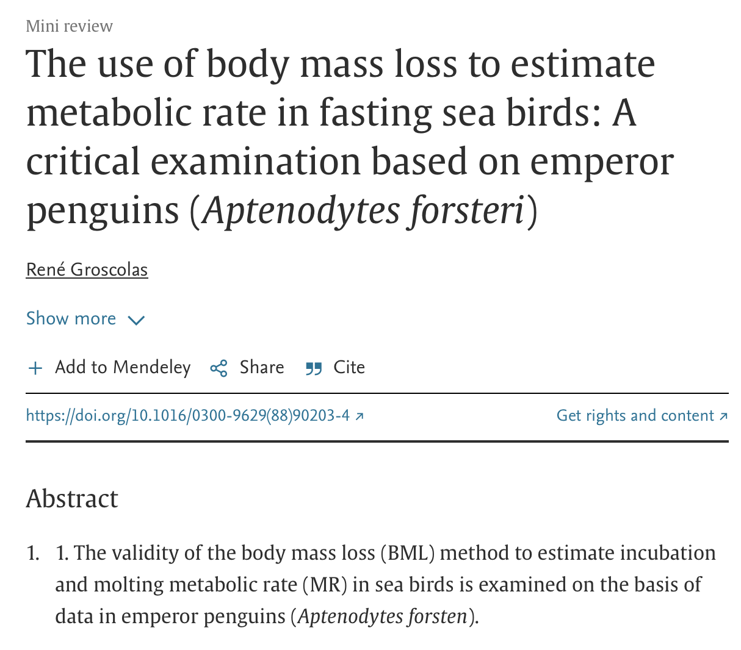
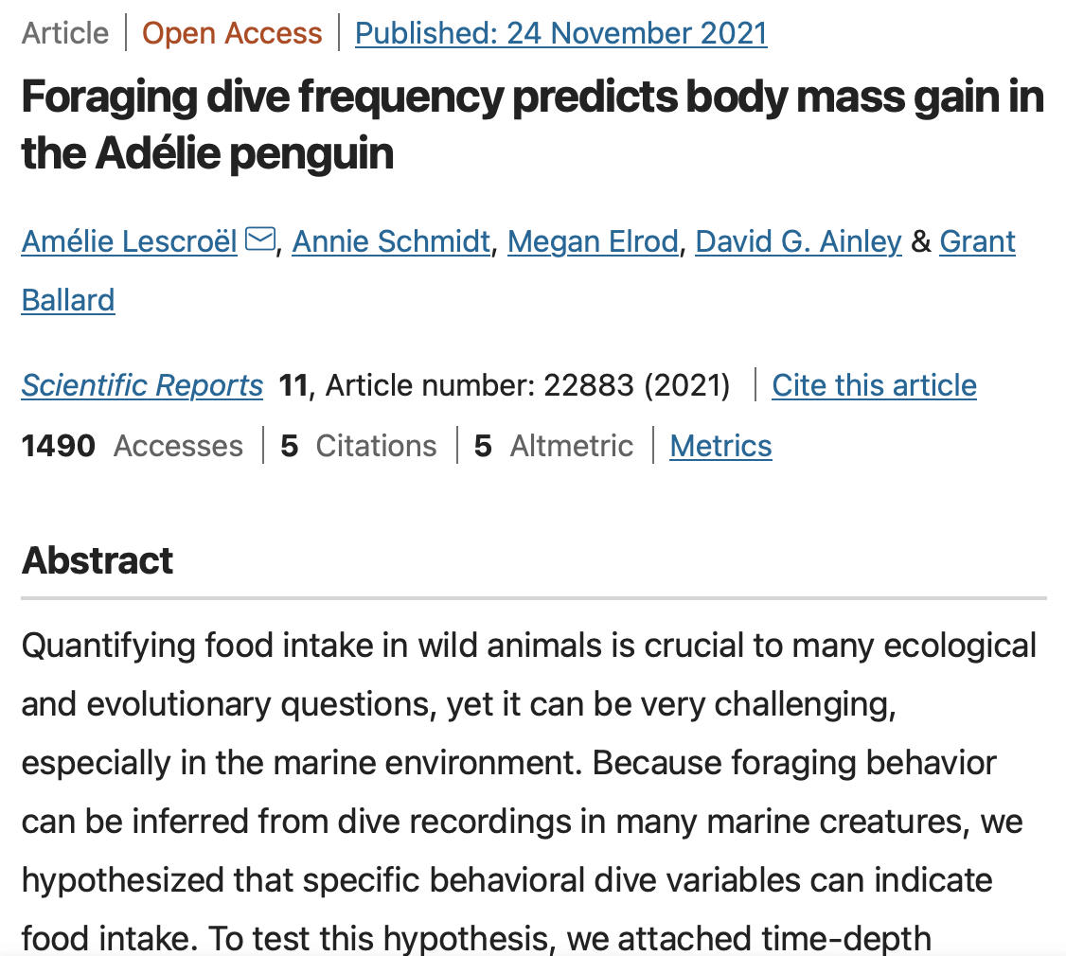
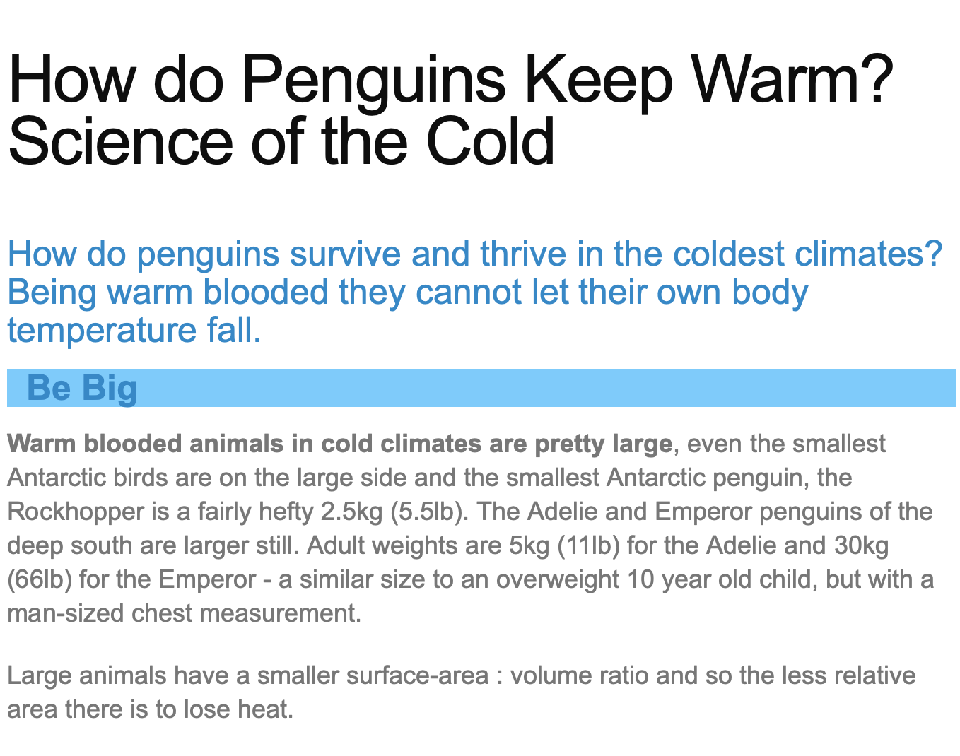
REFERENCES
CONCLUSION
INTERPRETATION / PREDICTION
DIANOSTIC CHECK
EXPLORATORY ANALYSIS
Here is the problems
Here is the Questions
DETAIL ANALYSIS
Here is Detail anaysis
Here is the Exploration
QUESTION OF INTEREST
Here is the Interpret/Prediction
DATA DESCRIPSTION
Final model uses Species, Bill Length, Flipper Length, Sex, Year, and interaction of Species and Sex .
Model can be useful in conservation biology
Decline in body mass observed over study years could indicate potential threats to penguin populations.
Help identify and mitigate threats to protect the penguin population
Need for further research in conservation biology.
Here is the References
PROBLEMS & MOTIVATION
PALMER PENGUINS
ABSTRACT
In this analysis, we use “Palmer penguins" dataset created by Dr. Kristen Gorman’s dataset who is a Marine Biology’s professor
We use different statistic method to build a multiple linear model that help us to estimate the body mass of penguins living in Antarctica by using species, island, sex, and other measurements of penguins’ bill and flipper.
Our final model to predict the body mass, we can use the variable such as species, bill length, flipper length, sex and years
GROUP 1:
HUITING WU
CLAUDIO HERNANDEZ GARCIA
MICHELLE JOYCE PIRA
THU TRAN

Slide 4
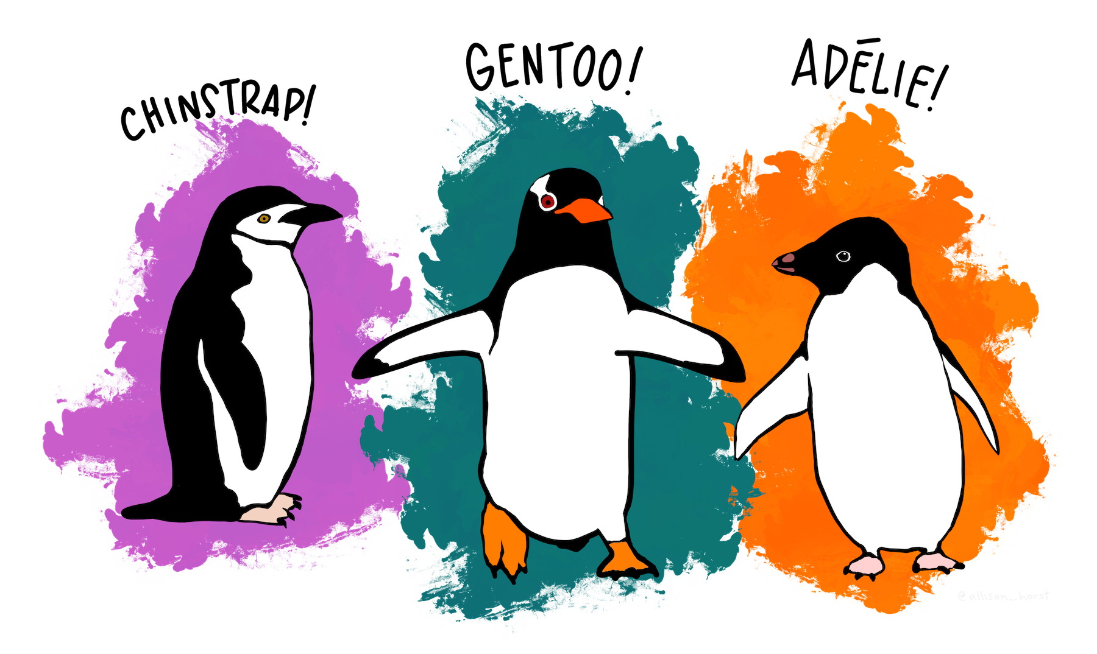
REFERENCES
CONCLUSION
INTERPRETATION / PREDICTION
DIANOSTIC CHECK
Here is the Questions
EXPLORATORY ANALYSIS
Here is Detail anaysis
Here is the Exploration
DETAIL ANALYSIS
Here is the Interpret/Prediction
QUESTION OF INTEREST
Final model uses Species, Bill Length, Flipper Length, Sex, Year, and interaction of Species and Sex .
Model can be useful in conservation biology
Decline in body mass observed over study years could indicate potential threats to penguin populations.
Help identify and mitigate threats to protect the penguin population
Need for further research in conservation biology.
Here is the References
DATA DESCRIPSTION
PALMER PENGUINS
Here is the problems
SPECIES
PROBLEMS & MOTIVATION
ABSTRACT
GROUP 1:
HUITING WU
CLAUDIO HERNANDEZ GARCIA
MICHELLE JOYCE PIRA
THU TRAN
Here is the abstract

Slide 5
REFERENCES
CONCLUSION
INTERPRETATION / PREDICTION
DIANOSTIC CHECK
Here is the Questions
EXPLORATORY ANALYSIS
Here is Detail anaysis
Here is the Exploration
DETAIL ANALYSIS
Here is the Interpret/Prediction
QUESTION OF INTEREST
Final model uses Species, Bill Length, Flipper Length, Sex, Year, and interaction of Species and Sex .
Model can be useful in conservation biology
Decline in body mass observed over study years could indicate potential threats to penguin populations.
Help identify and mitigate threats to protect the penguin population
Need for further research in conservation biology.
Here is the References
DATA DESCRIPSTION
PALMER PENGUINS
SPECIES
PROBLEMS & MOTIVATION
Understanding ecology and behavior of penguin species
Monitoring changes in penguin populations over time
Body mass affects foraging, reproduction, and survival
Crucial role of body mass in penguin survival and reproduction
ABSTRACT
GROUP 1:
HUITING WU
CLAUDIO HERNANDEZ GARCIA
MICHELLE JOYCE PIRA
THU TRAN
Here is the abstract

Slide 6
REFERENCES
CONCLUSION
INTERPRETATION / PREDICTION
DIANOSTIC CHECK
Here is the Questions
EXPLORATORY ANALYSIS
Here is Detail anaysis
Here is the Exploration
DETAIL ANALYSIS
Here is the Interpret/Prediction
Final model uses Species, Bill Length, Flipper Length, Sex, Year, and interaction of Species and Sex .
Model can be useful in conservation biology
Decline in body mass observed over study years could indicate potential threats to penguin populations.
Help identify and mitigate threats to protect the penguin population
Need for further research in conservation biology.
Here is the References
DATA DESCRIPSTION
PALMER PENGUINS
SPECIES
QUESTION OF INTEREST
“What factors are most strongly associated with the body mass of penguins, and how accurately can we predict their body mass using these factors?”
ABSTRACT
GROUP 1:
HUITING WU
CLAUDIO HERNANDEZ GARCIA
MICHELLE JOYCE PIRA
THU TRAN
Here is the abstract

Slide 7
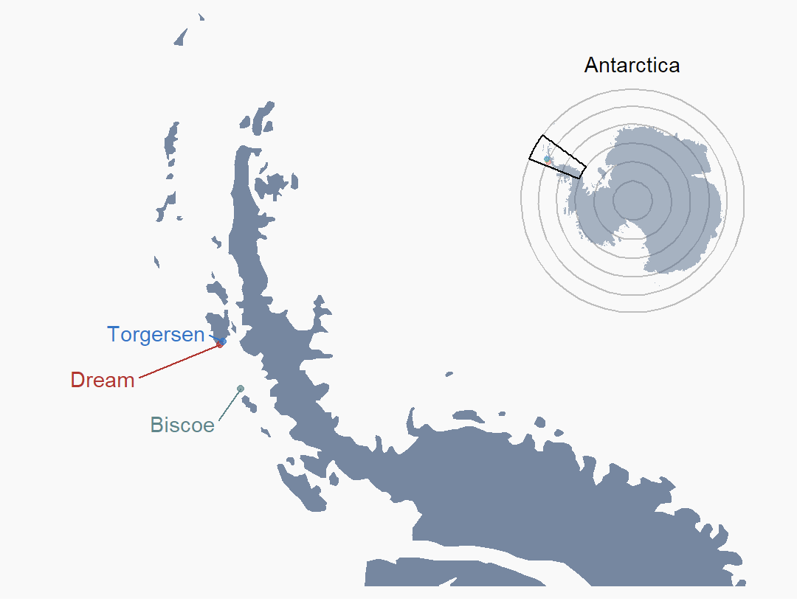
REFERENCES
CONCLUSION
INTERPRETATION / PREDICTION
Here is the Questions
DIANOSTIC CHECK
Here is Detail anaysis
Here is the Exploration
EXPLORATORY ANALYSIS
Here is the Interpret/Prediction
DETAIL ANALYSIS
Final model uses Species, Bill Length, Flipper Length, Sex, Year, and interaction of Species and Sex .
Model can be useful in conservation biology
Decline in body mass observed over study years could indicate potential threats to penguin populations.
Help identify and mitigate threats to protect the penguin population
Need for further research in conservation biology.
Here is the References
QUESTION OF INTEREST
PALMER PENGUINS
ISLAND
DATA DESCRIPSTION
SPECIES
PROBLEMS & MOTIVATION
GROUP 1:
HUITING WU
CLAUDIO HERNANDEZ GARCIA
MICHELLE JOYCE PIRA
THU TRAN
ABSTRACT
Here is the abstract
Here is the problems

Slide 8

REFERENCES
CONCLUSION
INTERPRETATION / PREDICTION
Here is the Questions
DIANOSTIC CHECK
Here is Detail anaysis
Here is the Exploration
EXPLORATORY ANALYSIS
Here is the Interpret/Prediction
DETAIL ANALYSIS
Final model uses Species, Bill Length, Flipper Length, Sex, Year, and interaction of Species and Sex .
Model can be useful in conservation biology
Decline in body mass observed over study years could indicate potential threats to penguin populations.
Help identify and mitigate threats to protect the penguin population
Need for further research in conservation biology.
Here is the References
QUESTION OF INTEREST
PALMER PENGUINS
SEX
DATA DESCRIPSTION
ISLAND
PROBLEMS & MOTIVATION
SPECIES
GROUP 1:
HUITING WU
CLAUDIO HERNANDEZ GARCIA
MICHELLE JOYCE PIRA
THU TRAN
ABSTRACT
Here is the abstract
Here is the problems

Slide 9

REFERENCES
CONCLUSION
INTERPRETATION / PREDICTION
Here is the Questions
DIANOSTIC CHECK
Here is Detail anaysis
Here is the Exploration
EXPLORATORY ANALYSIS
Here is the Interpret/Prediction
DETAIL ANALYSIS
Final model uses Species, Bill Length, Flipper Length, Sex, Year, and interaction of Species and Sex .
Model can be useful in conservation biology
Decline in body mass observed over study years could indicate potential threats to penguin populations.
Help identify and mitigate threats to protect the penguin population
Need for further research in conservation biology.
Here is the References
QUESTION OF INTEREST
PALMER PENGUINS
MEASUREMENTS
DATA DESCRIPSTION
SEX
Bill length
Bill depth
Flipper length
PROBLEMS & MOTIVATION
ISLAND
SPECIES
GROUP 1:
HUITING WU
CLAUDIO HERNANDEZ GARCIA
MICHELLE JOYCE PIRA
THU TRAN
ABSTRACT
Here is the abstract
Here is the problems

Slide 10
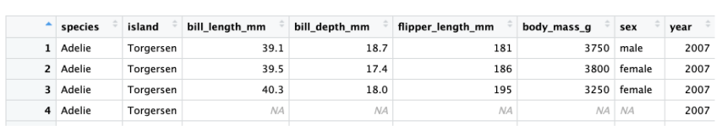
REFERENCES
CONCLUSION
INTERPRETATION / PREDICTION
Here is the Questions
DIANOSTIC CHECK
Here is Detail anaysis
Here is the Exploration
EXPLORATORY ANALYSIS
Here is the Interpret/Prediction
DETAIL ANALYSIS
Final model uses Species, Bill Length, Flipper Length, Sex, Year, and interaction of Species and Sex .
Model can be useful in conservation biology
Decline in body mass observed over study years could indicate potential threats to penguin populations.
Help identify and mitigate threats to protect the penguin population
Need for further research in conservation biology.
Here is the References
QUESTION OF INTEREST
PALMER PENGUINS
N/A remove
DATA DESCRIPSTION
MEASUREMENTS
RAW Dataset
Bill length
Bill depth
344 col * 8 row
Flipper length
342 col * 8 row
PROBLEMS & MOTIVATION
SEX
ISLAND
SPECIES
GROUP 1:
HUITING WU
CLAUDIO HERNANDEZ GARCIA
MICHELLE JOYCE PIRA
THU TRAN
ABSTRACT
Here is the abstract
Here is the problems

Slide 11

REFERENCES
CONCLUSION
INTERPRETATION / PREDICTION
Here is the Questions
DIANOSTIC CHECK
Here is Detail anaysis
Here is the Exploration
EXPLORATORY ANALYSIS
Here is the Interpret/Prediction
DETAIL ANALYSIS
Final model uses Species, Bill Length, Flipper Length, Sex, Year, and interaction of Species and Sex .
Model can be useful in conservation biology
Decline in body mass observed over study years could indicate potential threats to penguin populations.
Help identify and mitigate threats to protect the penguin population
Need for further research in conservation biology.
Here is the References
EXPLORE THE DATA
PALMER PENGUINS
DATA DESCRIPSTION
RAW Dataset
344 row * 8 col
N/A remove
333 row * 8 col
PROBLEMS & MOTIVATION
SEX
ISLAND
MEASUREMENTS
SPECIES
Bill length
Bill depth
GROUP 1:
HUITING WU
CLAUDIO HERNANDEZ GARCIA
MICHELLE JOYCE PIRA
THU TRAN
Flipper length
ABSTRACT
Here is the abstract
Here is the problems

Slide 12
REFERENCES
CONCLUSION
Here is the Questions
INTERPRETATION / PREDICTION
Here is Detail anaysis
Here is the Exploration
DIANOSTIC CHECK
Here is the Interpret/Prediction
EXPLORATORY ANALYSIS
Final model uses Species, Bill Length, Flipper Length, Sex, Year, and interaction of Species and Sex .
Model can be useful in conservation biology
Decline in body mass observed over study years could indicate potential threats to penguin populations.
Help identify and mitigate threats to protect the penguin population
Need for further research in conservation biology.
Here is the References
DETAIL ANALYSIS
PALMER PENGUINS
EXPLORE THE DATA
DATA DESCRIPSTION
SEX
ISLAND
MEASUREMENTS
SPECIES
N/A remove
Bill length
Bill depth
GROUP 1:
HUITING WU
CLAUDIO HERNANDEZ GARCIA
MICHELLE JOYCE PIRA
THU TRAN
Flipper length
PROBLEMS & MOTIVATION
Here is the abstract
Here is the problems
ABSTRACT

Slide 13
REFERENCES
CONCLUSION
Here is the Questions
INTERPRETATION / PREDICTION
Here is Detail anaysis
Here is the Exploration
DIANOSTIC CHECK
Here is the Interpret/Prediction
EXPLORATORY ANALYSIS
Final model uses Species, Bill Length, Flipper Length, Sex, Year, and interaction of Species and Sex .
Model can be useful in conservation biology
Decline in body mass observed over study years could indicate potential threats to penguin populations.
Help identify and mitigate threats to protect the penguin population
Need for further research in conservation biology.
Here is the References
DETAIL ANALYSIS
E (Body Mass) = ß₀ + ß₁ *Species +
ß₂ *Island + ß₃ *Bill_depth +
PALMER PENGUINS
ß₄ *Bill_length + ß₅*Flipper_length +
ß₆ * Sex + ß₇ * Year
FULL MODEL:
EXPLORE THE DATA
DATA DESCRIPSTION
SEX
ISLAND
MEASUREMENTS
SPECIES
N/A remove
Bill length
Bill depth
GROUP 1:
HUITING WU
CLAUDIO HERNANDEZ GARCIA
MICHELLE JOYCE PIRA
THU TRAN
Flipper length
PROBLEMS & MOTIVATION
Here is the abstract
Here is the problems
ABSTRACT

Slide 14
REFERENCES
Here is the Questions
CONCLUSION
Here is Detail anaysis
Here is the Exploration
INTERPRETATION / PREDICTION
Here is the Interpret/Prediction
DIANOSTIC CHECK
Final model uses Species, Bill Length, Flipper Length, Sex, Year, and interaction of Species and Sex .
Model can be useful in conservation biology
Decline in body mass observed over study years could indicate potential threats to penguin populations.
Help identify and mitigate threats to protect the penguin population
Need for further research in conservation biology.
Here is the References
EXPLORATORY ANALYSIS
PALMER PENGUINS
DETAIL ANALYSIS
FULL MODEL:
E (Body Mass) = ß₀ + ß₁ *Species +
ß₂ *Island + ß₃ *Bill_depth +
ß₄ *Bill_length + ß₅*Flipper_length +
ß₆ * Sex + ß₇ * Year
EXPLORE THE DATA
SEX
ISLAND
MEASUREMENTS
SPECIES
N/A remove
Bill length
Bill depth
GROUP 1:
HUITING WU
CLAUDIO HERNANDEZ GARCIA
MICHELLE JOYCE PIRA
THU TRAN
Flipper length
DATA DESCRIPSTION
Here is the abstract
Here is the problems
PROBLEMS & MOTIVATION
ABSTRACT

Slide 15
REFERENCES
Here is the Questions
CONCLUSION
Here is Detail anaysis
Here is the Exploration
INTERPRETATION / PREDICTION
Here is the Interpret/Prediction
DIANOSTIC CHECK
Final model uses Species, Bill Length, Flipper Length, Sex, Year, and interaction of Species and Sex .
Model can be useful in conservation biology
Decline in body mass observed over study years could indicate potential threats to penguin populations.
Help identify and mitigate threats to protect the penguin population
Need for further research in conservation biology.
Here is the References
EXPLORATORY ANALYSIS
PALMER PENGUINS
DETAIL ANALYSIS
FULL MODEL:
E (Body Mass) = ß₀ + ß₁ *Species +
ß₂ *Island + ß₃ *Bill_depth +
ß₄ *Bill_length + ß₅*Flipper_length +
ß₆ * Sex + ß₇ * Year
EXPLORE THE DATA
SEX
ISLAND
MEASUREMENTS
SPECIES
N/A remove
Bill length
Bill depth
GROUP 1:
HUITING WU
CLAUDIO HERNANDEZ GARCIA
MICHELLE JOYCE PIRA
THU TRAN
Flipper length
DATA DESCRIPSTION
Here is the abstract
Here is the problems
PROBLEMS & MOTIVATION
ABSTRACT

Slide 16
REFERENCES
Here is the Questions
CONCLUSION
Here is Detail anaysis
Here is the Exploration
INTERPRETATION / PREDICTION
Here is the Interpret/Prediction
DIANOSTIC CHECK
Final model uses Species, Bill Length, Flipper Length, Sex, Year, and interaction of Species and Sex .
Model can be useful in conservation biology
Decline in body mass observed over study years could indicate potential threats to penguin populations.
Help identify and mitigate threats to protect the penguin population
Need for further research in conservation biology.
Here is the References
EXPLORATORY ANALYSIS
PALMER PENGUINS
DETAIL ANALYSIS
REDUCED MODEL:
E (Body Mass) = ß₀ + ß₁ *Species +
ß₄ *Bill_length + ß₅*Flipper_length +
ß₆ * Sex + ß₇ * Year
ß₈ * Species: Sex
ß₈ * Species: Sex
ß₈ * Species: Sex
EXPLORE THE DATA
SEX
ISLAND
MEASUREMENTS
SPECIES
N/A remove
Bill length
Bill depth
GROUP 1:
HUITING WU
CLAUDIO HERNANDEZ GARCIA
MICHELLE JOYCE PIRA
THU TRAN
Flipper length
DATA DESCRIPSTION
Here is the abstract
Here is the problems
PROBLEMS & MOTIVATION
ABSTRACT

Slide 17
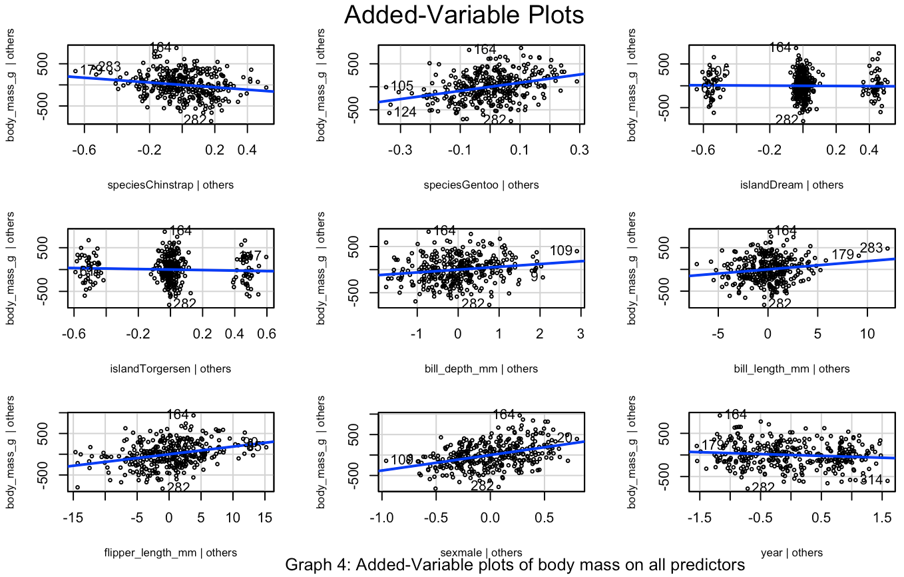
REFERENCES
Here is the Questions
CONCLUSION
Here is Detail anaysis
Here is the Exploration
INTERPRETATION / PREDICTION
Here is the Interpret/Prediction
DIANOSTIC CHECK
Final model uses Species, Bill Length, Flipper Length, Sex, Year, and interaction of Species and Sex .
Model can be useful in conservation biology
Decline in body mass observed over study years could indicate potential threats to penguin populations.
Help identify and mitigate threats to protect the penguin population
Need for further research in conservation biology.
Here is the References
EXPLORATORY ANALYSIS
PALMER PENGUINS
DETAIL ANALYSIS
ß₂ *Island + ß₃ *Bill_depth
FINAL MODEL:
E (Body Mass) = ß₀ + ß₁ *Species +
ß₄ *Bill_length + ß₅*Flipper_length +
ß₆ * Sex + ß₇ * Year
ß₈ * Species: Sex
ß₈ * Species: Sex
EXPLORE THE DATA
SEX
ISLAND
MEASUREMENTS
SPECIES
N/A remove
Bill length
Bill depth
GROUP 1:
HUITING WU
CLAUDIO HERNANDEZ GARCIA
MICHELLE JOYCE PIRA
THU TRAN
Flipper length
DATA DESCRIPSTION
Here is the abstract
Here is the problems
PROBLEMS & MOTIVATION
ABSTRACT

Slide 18
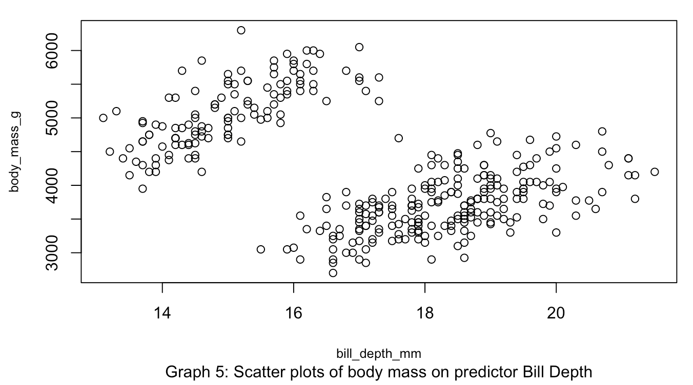
REFERENCES
Here is the Questions
CONCLUSION
Here is Detail anaysis
Here is the Exploration
INTERPRETATION / PREDICTION
Here is the Interpret/Prediction
DIANOSTIC CHECK
Final model uses Species, Bill Length, Flipper Length, Sex, Year, and interaction of Species and Sex .
Model can be useful in conservation biology
Decline in body mass observed over study years could indicate potential threats to penguin populations.
Help identify and mitigate threats to protect the penguin population
Need for further research in conservation biology.
Here is the References
PALMER PENGUINS
DETAIL ANALYSIS
EXPLORATORY ANALYSIS
ß₂ *Island + ß₃ *Bill_depth
SEX
INTERACTION MODEL:
ISLAND
MEASUREMENTS
SPECIES
E (Body Mass) = ß₀ + ß₁ *Species +
N/A remove
ß₄ *Bill_length + ß₅*Flipper_length +
ß₆ * Sex + ß₇ * Year
ß₈ * Species: Sex
Bill length
Bill depth
GROUP 1:
HUITING WU
CLAUDIO HERNANDEZ GARCIA
MICHELLE JOYCE PIRA
THU TRAN
Flipper length
DATA DESCRIPSTION
Here is the abstract
EXPLORE THE DATA
Here is the problems
PROBLEMS & MOTIVATION
ABSTRACT

Slide 19
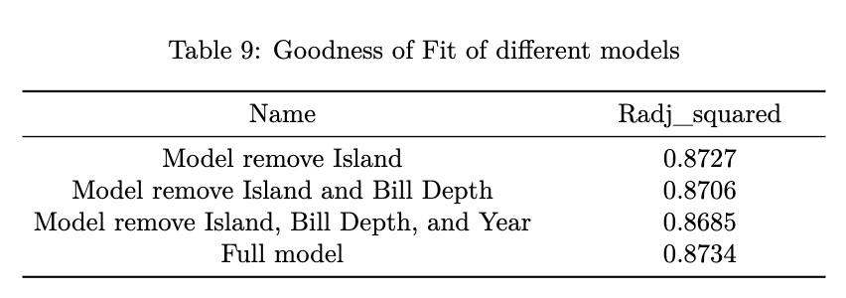
REFERENCES
Here is the Questions
CONCLUSION
Here is Detail anaysis
Here is the Exploration
INTERPRETATION / PREDICTION
Here is the Interpret/Prediction
DIANOSTIC CHECK
Final model uses Species, Bill Length, Flipper Length, Sex, Year, and interaction of Species and Sex .
Model can be useful in conservation biology
Decline in body mass observed over study years could indicate potential threats to penguin populations.
Help identify and mitigate threats to protect the penguin population
Need for further research in conservation biology.
Here is the References
PALMER PENGUINS
DETAIL ANALYSIS
EXPLORATORY ANALYSIS
ß₂ *Island + ß₃ *Bill_depth
SEX
INTERACTION MODEL:
ISLAND
MEASUREMENTS
SPECIES
E (Body Mass) = ß₀ + ß₁ *Species +
N/A remove
ß₄ *Bill_length + ß₅*Flipper_length +
ß₆ * Sex + ß₇ * Year
ß₈ * Species: Sex
Bill length
Bill depth
GROUP 1:
HUITING WU
CLAUDIO HERNANDEZ GARCIA
MICHELLE JOYCE PIRA
THU TRAN
Flipper length
DATA DESCRIPSTION
Here is the abstract
EXPLORE THE DATA
Here is the problems
PROBLEMS & MOTIVATION
ABSTRACT

Slide 20
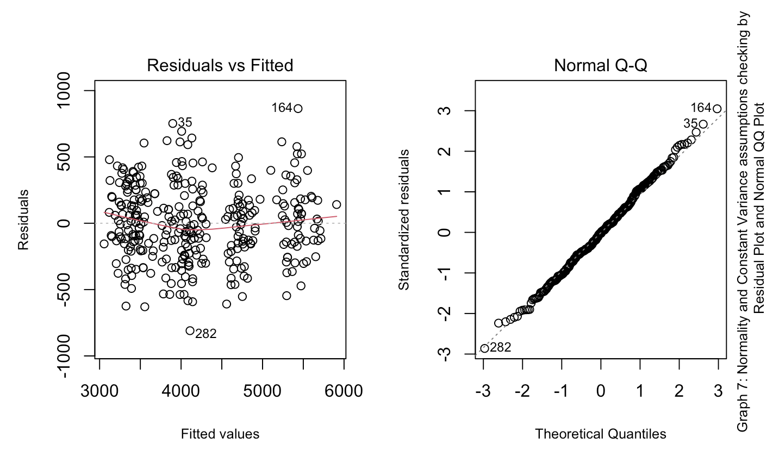
REFERENCES
Here is the Questions
CONCLUSION
Here is Detail anaysis
Here is the Exploration
INTERPRETATION / PREDICTION
Here is the Interpret/Prediction
DIANOSTIC CHECK
Final model uses Species, Bill Length, Flipper Length, Sex, Year, and interaction of Species and Sex .
Model can be useful in conservation biology
Decline in body mass observed over study years could indicate potential threats to penguin populations.
Help identify and mitigate threats to protect the penguin population
Need for further research in conservation biology.
Here is the References
PALMER PENGUINS
DETAIL ANALYSIS
EXPLORATORY ANALYSIS
Check assumption (w/o interaction)
ß₂ *Island + ß₃ *Bill_depth
SEX
INTERACTION MODEL:
ISLAND
MEASUREMENTS
SPECIES
E (Body Mass) = ß₀ + ß₁ *Species +
N/A remove
ß₄ *Bill_length + ß₅*Flipper_length +
ß₆ * Sex + ß₇ * Year
ß₈ * Species: Sex
Bill length
Bill depth
GROUP 1:
HUITING WU
CLAUDIO HERNANDEZ GARCIA
MICHELLE JOYCE PIRA
THU TRAN
Flipper length
DATA DESCRIPSTION
Here is the abstract
EXPLORE THE DATA
Here is the problems
PROBLEMS & MOTIVATION
ABSTRACT

Slide 21
REFERENCES
Here is the Questions
CONCLUSION
Here is Detail anaysis
Here is the Exploration
INTERPRETATION / PREDICTION
Here is the Interpret/Prediction
DIANOSTIC CHECK
Final model uses Species, Bill Length, Flipper Length, Sex, Year, and interaction of Species and Sex .
Model can be useful in conservation biology
Decline in body mass observed over study years could indicate potential threats to penguin populations.
Help identify and mitigate threats to protect the penguin population
Need for further research in conservation biology.
Here is the References
PALMER PENGUINS
DETAIL ANALYSIS
EXPLORATORY ANALYSIS
Check assumption (w/o interaction)
SEX
INTERACTION MODEL:
ISLAND
MEASUREMENTS
SPECIES
E (Body Mass) = ß₀ + ß₁ *Species +
ß₂ *Island + ß₃ *Bill_depth
N/A remove
ß₄ *Bill_length + ß₅*Flipper_length +
ß₆ * Sex + ß₇ * Year
ß₈ * Species: Sex
Bill length
Bill depth
GROUP 1:
HUITING WU
CLAUDIO HERNANDEZ GARCIA
MICHELLE JOYCE PIRA
THU TRAN
Flipper length
DATA DESCRIPSTION
Here is the abstract
EXPLORE THE DATA
Here is the problems
PROBLEMS & MOTIVATION
ABSTRACT

Slide 22
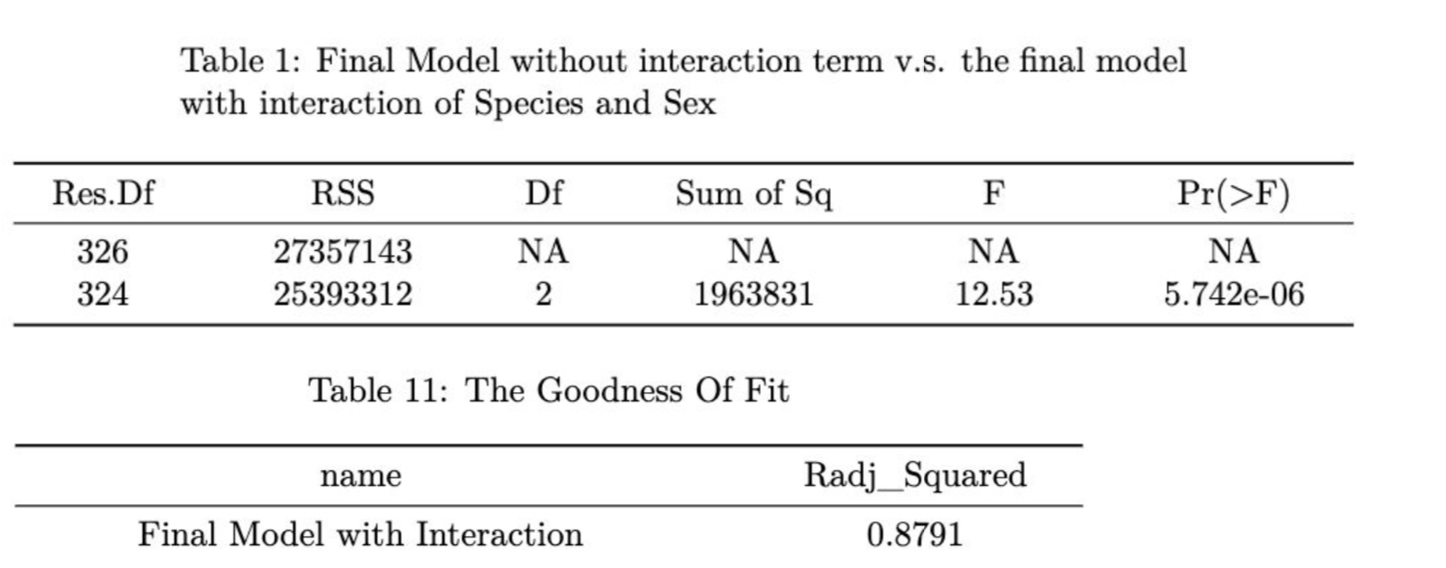
REFERENCES
Here is the Questions
CONCLUSION
Here is Detail anaysis
Here is the Exploration
INTERPRETATION / PREDICTION
Here is the Interpret/Prediction
DIANOSTIC CHECK
Final model uses Species, Bill Length, Flipper Length, Sex, Year, and interaction of Species and Sex .
Model can be useful in conservation biology
Decline in body mass observed over study years could indicate potential threats to penguin populations.
Help identify and mitigate threats to protect the penguin population
Need for further research in conservation biology.
Here is the References
PALMER PENGUINS
DETAIL ANALYSIS
EXPLORATORY ANALYSIS
Check assumption (w/o interaction)
Does interaction happen among variables?
SEX
INTERACTION MODEL:
ISLAND
MEASUREMENTS
SPECIES
E (Body Mass) = ß₀ + ß₁ *Species +
ß₂ *Island + ß₃ *Bill_depth
N/A remove
ß₄ *Bill_length + ß₅*Flipper_length +
ß₆ * Sex + ß₇ * Year
ß₈ * Species: Sex
Bill length
Bill depth
GROUP 1:
HUITING WU
CLAUDIO HERNANDEZ GARCIA
MICHELLE JOYCE PIRA
THU TRAN
Flipper length
DATA DESCRIPSTION
Here is the abstract
EXPLORE THE DATA
Here is the problems
PROBLEMS & MOTIVATION
ABSTRACT

Slide 23
REFERENCES
Here is the Questions
CONCLUSION
Here is Detail anaysis
Here is the Exploration
INTERPRETATION / PREDICTION
Here is the Interpret/Prediction
DIANOSTIC CHECK
Final model uses Species, Bill Length, Flipper Length, Sex, Year, and interaction of Species and Sex .
Model can be useful in conservation biology
Decline in body mass observed over study years could indicate potential threats to penguin populations.
Help identify and mitigate threats to protect the penguin population
Need for further research in conservation biology.
Here is the References
PALMER PENGUINS
DETAIL ANALYSIS
EXPLORATORY ANALYSIS
SEX
INTERACTION MODEL:
ISLAND
MEASUREMENTS
SPECIES
Check assumption (w/o interaction)
E (Body Mass) = ß₀ + ß₁ *Species +
ß₂ *Island + ß₃ *Bill_depth
N/A remove
ß₄ *Bill_length + ß₅*Flipper_length +
Does any variables have interactions ?
ß₆ * Sex + ß₇ * Year
ß₈ * Species: Sex
Bill length
Bill depth
GROUP 1:
HUITING WU
CLAUDIO HERNANDEZ GARCIA
MICHELLE JOYCE PIRA
THU TRAN
Flipper length
DATA DESCRIPSTION
Here is the abstract
EXPLORE THE DATA
Here is the problems
PROBLEMS & MOTIVATION
ABSTRACT

Slide 24
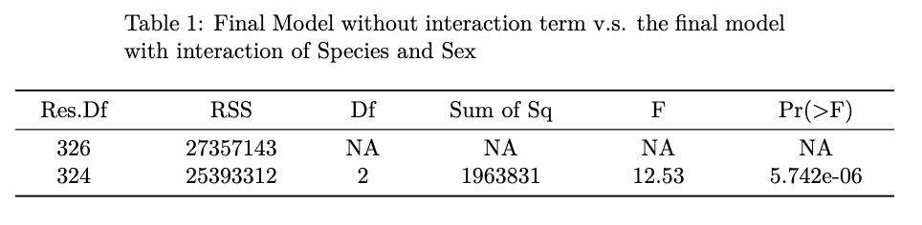
REFERENCES
Here is the Questions
CONCLUSION
Here is Detail anaysis
Here is the Exploration
INTERPRETATION / PREDICTION
Here is the Interpret/Prediction
DIANOSTIC CHECK
Final model uses Species, Bill Length, Flipper Length, Sex, Year, and interaction of Species and Sex .
Model can be useful in conservation biology
Decline in body mass observed over study years could indicate potential threats to penguin populations.
Help identify and mitigate threats to protect the penguin population
Need for further research in conservation biology.
Here is the References
PALMER PENGUINS
DETAIL ANALYSIS
EXPLORATORY ANALYSIS
FINAL MODEL:
E (Body Mass) = ß₀ + ß₁ *Species +
ß₄ *Bill_length + ß₅*Flipper_length +
ß₆ * Sex + ß₇ * Year
ß₈ * Species: Sex
SEX
INTERACTION MODEL:
ISLAND
MEASUREMENTS
SPECIES
Check assumption (w/o interaction)
E (Body Mass) = ß₀ + ß₁ *Species +
ß₂ *Island + ß₃ *Bill_depth
N/A remove
ß₄ *Bill_length + ß₅*Flipper_length +
Does any variables have interactions ?
ß₆ * Sex + ß₇ * Year
ß₈ * Species: Sex
Bill length
Bill depth
GROUP 1:
HUITING WU
CLAUDIO HERNANDEZ GARCIA
MICHELLE JOYCE PIRA
THU TRAN
Flipper length
DATA DESCRIPSTION
Here is the abstract
EXPLORE THE DATA
Here is the problems
PROBLEMS & MOTIVATION
ABSTRACT

Slide 25
REFERENCES
Here is the Questions
CONCLUSION
Here is Detail anaysis
Here is the Exploration
INTERPRETATION / PREDICTION
Here is the Interpret/Prediction
Final model uses Species, Bill Length, Flipper Length, Sex, Year, and interaction of Species and Sex .
Model can be useful in conservation biology
Decline in body mass observed over study years could indicate potential threats to penguin populations.
Help identify and mitigate threats to protect the penguin population
Need for further research in conservation biology.
Here is the References
PALMER PENGUINS
DIAGNOSTIC CHECK
EXPLORATORY ANALYSIS
SEX
INTERACTION MODEL:
ISLAND
MEASUREMENTS
SPECIES
Check assumption (w/o interaction)
E (Body Mass) = ß₀ + ß₁ *Species +
ß₂ *Island + ß₃ *Bill_depth
N/A remove
ß₄ *Bill_length + ß₅*Flipper_length +
Does any variables have interactions ?
INTERACTION MODEL:
ß₆ * Sex + ß₇ * Year
E (Body Mass) = ß₀ + ß₁ *Species +
Bill length
ß₈ * Species: Sex
ß₄ *Bill_length + ß₅*Flipper_length +
Bill depth
GROUP 1:
HUITING WU
CLAUDIO HERNANDEZ GARCIA
MICHELLE JOYCE PIRA
THU TRAN
ß₆ * Sex + ß₇ * Year
Flipper length
DATA DESCRIPSTION
ß₈ * Species: Sex
Here is the abstract
EXPLORE THE DATA
Here is the problems
PROBLEMS & MOTIVATION
ABSTRACT

Slide 26
REFERENCES
Here is the Questions
CONCLUSION
Here is Detail anaysis
Here is the Exploration
INTERPRETATION / PREDICTION
Here is the Interpret/Prediction
Final model uses Species, Bill Length, Flipper Length, Sex, Year, and interaction of Species and Sex .
Model can be useful in conservation biology
Decline in body mass observed over study years could indicate potential threats to penguin populations.
Help identify and mitigate threats to protect the penguin population
Need for further research in conservation biology.
Here is the References
PALMER PENGUINS
DIAGNOSTIC CHECK
EXPLORATORY ANALYSIS
The final model :
Body_mass = 106016.439 - 159.381*Species(Chinstrap)
+ 588.490*Species(Gentoo)
+ 24.850*Bill Length
+ 20.743* Flipper Length
+ 501.046 *Sex(Male)
- 53.519*Year
- 371.224*Species(Chinstrap)*Sex(male)
+ 23.457*Species(Gentoo)*Sex(male)
SEX
INTERACTION MODEL:
ISLAND
MEASUREMENTS
SPECIES
Check assumption (w/o interaction)
E (Body Mass) = ß₀ + ß₁ *Species +
ß₂ *Island + ß₃ *Bill_depth
N/A remove
ß₄ *Bill_length + ß₅*Flipper_length +
Does any variables have interactions ?
INTERACTION MODEL:
ß₆ * Sex + ß₇ * Year
E (Body Mass) = ß₀ + ß₁ *Species +
Bill length
ß₈ * Species: Sex
ß₄ *Bill_length + ß₅*Flipper_length +
Bill depth
GROUP 1:
HUITING WU
CLAUDIO HERNANDEZ GARCIA
MICHELLE JOYCE PIRA
THU TRAN
ß₆ * Sex + ß₇ * Year
Flipper length
DATA DESCRIPSTION
ß₈ * Species: Sex
Here is the abstract
EXPLORE THE DATA
Here is the problems
PROBLEMS & MOTIVATION
ABSTRACT

Slide 27
REFERENCES
Here is the Questions
CONCLUSION
Here is Detail anaysis
Here is the Exploration
Here is the Interpret/Prediction
Final model uses Species, Bill Length, Flipper Length, Sex, Year, and interaction of Species and Sex .
Model can be useful in conservation biology
Decline in body mass observed over study years could indicate potential threats to penguin populations.
Help identify and mitigate threats to protect the penguin population
Need for further research in conservation biology.
Here is the References
PALMER PENGUINS
267
193
DIANOSTIC CHECK
INTERPRETATION / PREDICTION
THE FINAL MODEL :
Body_mass = 106016.439 - 159.381*Species(Chinstrap)
+ 588.490*Species(Gentoo)
+ 24.850*Bill Length
+ 20.743* Flipper Length
+ 501.046 *Sex(Male)
- 53.519*Year
- 371.224*Species(Chinstrap) : Sex(male)
+ 23.457*Species(Gentoo) : Sex(male)
136
SEX
INTERACTION MODEL:
ISLAND
MEASUREMENTS
SPECIES
Check assumption (w/o interaction)
E (Body Mass) = ß₀ + ß₁ *Species +
ß₂ *Island + ß₃ *Bill_depth
N/A remove
ß₄ *Bill_length + ß₅*Flipper_length +
Does any variables have interactions ?
INTERACTION MODEL:
ß₆ * Sex + ß₇ * Year
E (Body Mass) = ß₀ + ß₁ *Species +
Bill length
ß₈ * Species: Sex
ß₄ *Bill_length + ß₅*Flipper_length +
Bill depth
GROUP 1:
HUITING WU
CLAUDIO HERNANDEZ GARCIA
MICHELLE JOYCE PIRA
THU TRAN
ß₆ * Sex + ß₇ * Year
Flipper length
DATA DESCRIPSTION
ß₈ * Species: Sex
Here is the abstract
EXPLORE THE DATA
Here is the problems
PROBLEMS & MOTIVATION
ABSTRACT

Slide 28
REFERENCES
Here is the Questions
CONCLUSION
Here is Detail anaysis
Here is the Exploration
Here is the Interpret/Prediction
Final model uses Species, Bill Length, Flipper Length, Sex, Year, and interaction of Species and Sex .
Model can be useful in conservation biology
Decline in body mass observed over study years could indicate potential threats to penguin populations.
Help identify and mitigate threats to protect the penguin population
Need for further research in conservation biology.
Here is the References
PALMER PENGUINS
DIANOSTIC CHECK
INTERPRETATION / PREDICTION
136
193
267
SEX
INTERACTION MODEL:
ISLAND
MEASUREMENTS
SPECIES
Check assumption (w/o interaction)
THE FINAL MODEL :
Body_mass = 106016.439 - 159.381*Species(Chinstrap)
+ 588.490*Species(Gentoo)
+ 24.850*Bill Length
+ 20.743* Flipper Length
+ 501.046 *Sex(Male)
- 53.519*Year
- 371.224*Species(Chinstrap) : Sex(male)
+ 23.457*Species(Gentoo) : Sex(male)
E (Body Mass) = ß₀ + ß₁ *Species +
ß₂ *Island + ß₃ *Bill_depth
N/A remove
ß₄ *Bill_length + ß₅*Flipper_length +
Does any variables have interactions ?
INTERACTION MODEL:
ß₆ * Sex + ß₇ * Year
E (Body Mass) = ß₀ + ß₁ *Species +
Bill length
ß₈ * Species: Sex
ß₄ *Bill_length + ß₅*Flipper_length +
Bill depth
GROUP 1:
HUITING WU
CLAUDIO HERNANDEZ GARCIA
MICHELLE JOYCE PIRA
THU TRAN
ß₆ * Sex + ß₇ * Year
Flipper length
DATA DESCRIPSTION
ß₈ * Species: Sex
Here is the abstract
EXPLORE THE DATA
Here is the problems
PROBLEMS & MOTIVATION
ABSTRACT

Slide 29
REFERENCES
Here is the Questions
CONCLUSION
Here is Detail anaysis
Here is the Exploration
Here is the Interpret/Prediction
Final model uses Species, Bill Length, Flipper Length, Sex, Year, and interaction of Species and Sex .
Model can be useful in conservation biology
Decline in body mass observed over study years could indicate potential threats to penguin populations.
Help identify and mitigate threats to protect the penguin population
Need for further research in conservation biology.
Here is the References
PALMER PENGUINS
DIANOSTIC CHECK
INTERPRETATION / PREDICTION
Bill_ length Flipper_length Sex Year
136
40.6 187 Male 2009
136
136
193
50.5 225 Male 2008
193
193
267
50 196 Male 2007
267
267
SEX
INTERACTION MODEL:
ISLAND
MEASUREMENTS
SPECIES
Check assumption (w/o interaction)
THE FINAL MODEL :
Body_mass = 106016.439 - 159.381*Species(Chinstrap)
+ 588.490*Species(Gentoo)
+ 24.850*Bill Length
+ 20.743* Flipper Length
+ 501.046 *Sex(Male)
- 53.519*Year
- 371.224*Species(Chinstrap) : Sex(male)
+ 23.457*Species(Gentoo) : Sex(male)
E (Body Mass) = ß₀ + ß₁ *Species +
ß₂ *Island + ß₃ *Bill_depth
N/A remove
ß₄ *Bill_length + ß₅*Flipper_length +
Does any variables have interactions ?
INTERACTION MODEL:
ß₆ * Sex + ß₇ * Year
E (Body Mass) = ß₀ + ß₁ *Species +
Bill length
ß₈ * Species: Sex
ß₄ *Bill_length + ß₅*Flipper_length +
Bill depth
GROUP 1:
HUITING WU
CLAUDIO HERNANDEZ GARCIA
MICHELLE JOYCE PIRA
THU TRAN
ß₆ * Sex + ß₇ * Year
Flipper length
DATA DESCRIPSTION
ß₈ * Species: Sex
Here is the abstract
EXPLORE THE DATA
Here is the problems
PROBLEMS & MOTIVATION
ABSTRACT

Slide 30
REFERENCES
Here is the Questions
CONCLUSION
Here is Detail anaysis
Here is the Exploration
Here is the Interpret/Prediction
Final model uses Species, Bill Length, Flipper Length, Sex, Year, and interaction of Species and Sex .
Model can be useful in conservation biology
Decline in body mass observed over study years could indicate potential threats to penguin populations.
Help identify and mitigate threats to protect the penguin population
Need for further research in conservation biology.
Here is the References
PALMER PENGUINS
DIANOSTIC CHECK
INTERPRETATION / PREDICTION
3475
3886
3328
4443
136
136
136
5400
5586
193
5030
6141
193
193
3883
3900
267
3322
4443
267
267
SEX
INTERACTION MODEL:
ISLAND
MEASUREMENTS
SPECIES
Check assumption (w/o interaction)
THE FINAL MODEL :
Body_mass = 106016.439 - 159.381*Species(Chinstrap)
+ 588.490*Species(Gentoo)
+ 24.850*Bill Length
+ 20.743* Flipper Length
+ 501.046 *Sex(Male)
- 53.519*Year
- 371.224*Species(Chinstrap) : Sex(male)
+ 23.457*Species(Gentoo) : Sex(male)
E (Body Mass) = ß₀ + ß₁ *Species +
ß₂ *Island + ß₃ *Bill_depth
N/A remove
ß₄ *Bill_length + ß₅*Flipper_length +
Does any variables have interactions ?
INTERACTION MODEL:
ß₆ * Sex + ß₇ * Year
E (Body Mass) = ß₀ + ß₁ *Species +
Bill length
ß₈ * Species: Sex
ß₄ *Bill_length + ß₅*Flipper_length +
Bill depth
GROUP 1:
HUITING WU
CLAUDIO HERNANDEZ GARCIA
MICHELLE JOYCE PIRA
THU TRAN
ß₆ * Sex + ß₇ * Year
Flipper length
DATA DESCRIPSTION
ß₈ * Species: Sex
Here is the abstract
EXPLORE THE DATA
Here is the problems
PROBLEMS & MOTIVATION
ABSTRACT

Slide 31
Here is the Questions
Here is Detail anaysis
Here is the Exploration
Here is the Interpret/Prediction
Here is the References
REFERENCES
PALMER PENGUINS
CONCLUSION
Final model uses Species, Bill Length, Flipper Length, Sex, Year, and interaction of Species and Sex .
During the analysis, there is a decline in body mass observed over study years could indicate potential threats to penguin populations.
This model help identify and mitigate threats to protect the penguin population
This model can help for further research in conservation biology (weather, food, habitat…).
Gorman, K. (n.d.). Palmerpenguins R Data Package. R data package •. Retrieved April 27, 2023, from https://allisonhorst.github.io/palmerpenguins/
https://www.nature.com/articles/s41598-021-02451-4
https://www.coolantarctica.com/Antarctica%20fact%20file/science/cold_penguins.php
3475
3886
3328
4443
SEX
136
136
136
INTERACTION MODEL:
ISLAND
MEASUREMENTS
SPECIES
Check assumption (w/o interaction)
THE FINAL MODEL :
Body_mass = 106016.439 - 159.381*Species(Chinstrap)
+ 588.490*Species(Gentoo)
+ 24.850*Bill Length
+ 20.743* Flipper Length
+ 501.046 *Sex(Male)
- 53.519*Year
- 371.224*Species(Chinstrap) : Sex(male)
+ 23.457*Species(Gentoo) : Sex(male)
5400
5586
E (Body Mass) = ß₀ + ß₁ *Species +
ß₂ *Island + ß₃ *Bill_depth
N/A remove
193
5030
6141
ß₄ *Bill_length + ß₅*Flipper_length +
193
193
Does any variables have interactions ?
INTERACTION MODEL:
ß₆ * Sex + ß₇ * Year
3883
3900
E (Body Mass) = ß₀ + ß₁ *Species +
3322
Bill length
4443
ß₈ * Species: Sex
267
267
267
ß₄ *Bill_length + ß₅*Flipper_length +
Bill depth
GROUP 1:
HUITING WU
CLAUDIO HERNANDEZ GARCIA
MICHELLE JOYCE PIRA
THU TRAN
ß₆ * Sex + ß₇ * Year
Flipper length
DATA DESCRIPSTION
ß₈ * Species: Sex
Here is the abstract
EXPLORE THE DATA
Here is the problems
PROBLEMS & MOTIVATION
ABSTRACT

Slide 32
Here is the Questions
Here is Detail anaysis
Here is the Exploration
Here is the Interpret/Prediction
Here is the References
PALMER PENGUINS
REFERENCES
Gorman, K. (n.d.). Palmerpenguins R Data Package. R data package •. Retrieved April 27, 2023, from https://allisonhorst.github.io/palmerpenguins/
https://www.nature.com/articles/s41598-021-02451-4
https://www.coolantarctica.com/Antarctica%20fact%20file/science/cold_penguins.php
https://www.sciencedirect.com/science/article/abs/pii/0300962988902034
CONCLUSION
3475
3886
3328
4443
SEX
136
136
136
INTERACTION MODEL:
ISLAND
MEASUREMENTS
SPECIES
Check assumption (w/o interaction)
THE FINAL MODEL :
Body_mass = 106016.439 - 159.381*Species(Chinstrap)
+ 588.490*Species(Gentoo)
+ 24.850*Bill Length
+ 20.743* Flipper Length
+ 501.046 *Sex(Male)
- 53.519*Year
- 371.224*Species(Chinstrap) : Sex(male)
+ 23.457*Species(Gentoo) : Sex(male)
5400
5586
E (Body Mass) = ß₀ + ß₁ *Species +
ß₂ *Island + ß₃ *Bill_depth
N/A remove
193
5030
6141
ß₄ *Bill_length + ß₅*Flipper_length +
193
193
Does any variables have interactions ?
INTERACTION MODEL:
ß₆ * Sex + ß₇ * Year
3883
3900
E (Body Mass) = ß₀ + ß₁ *Species +
3322
Bill length
4443
ß₈ * Species: Sex
267
267
267
ß₄ *Bill_length + ß₅*Flipper_length +
Bill depth
GROUP 1:
HUITING WU
CLAUDIO HERNANDEZ GARCIA
MICHELLE JOYCE PIRA
THU TRAN
ß₆ * Sex + ß₇ * Year
Flipper length
Final model uses Species, Bill Length, Flipper Length, Sex, Year, and interaction of Species and Sex .
Model can be useful in conservation biology
Decline in body mass observed over study years could indicate potential threats to penguin populations.
Help identify and mitigate threats to protect the penguin population
Need for further research in conservation biology.
ß₈ * Species: Sex
Here is the abstract
Here is the problems
DATA DESCRIPSTION
EXPLORE THE DATA
PROBLEMS & MOTIVATION
ABSTRACT

